Slide 1
Time Series Analysis 3
SYS 4021/6021
Laura Barnes and Julianne Quinn

Slide 2
Organization of lecture
Review of ARMA Models
Autoregressive Integrated Moving Average (ARIMA) Models
Time Series Model Diagnostics
Forecasting with Time Series Models
Box-Jenkins Method to Building Time Series Models

Slide 3
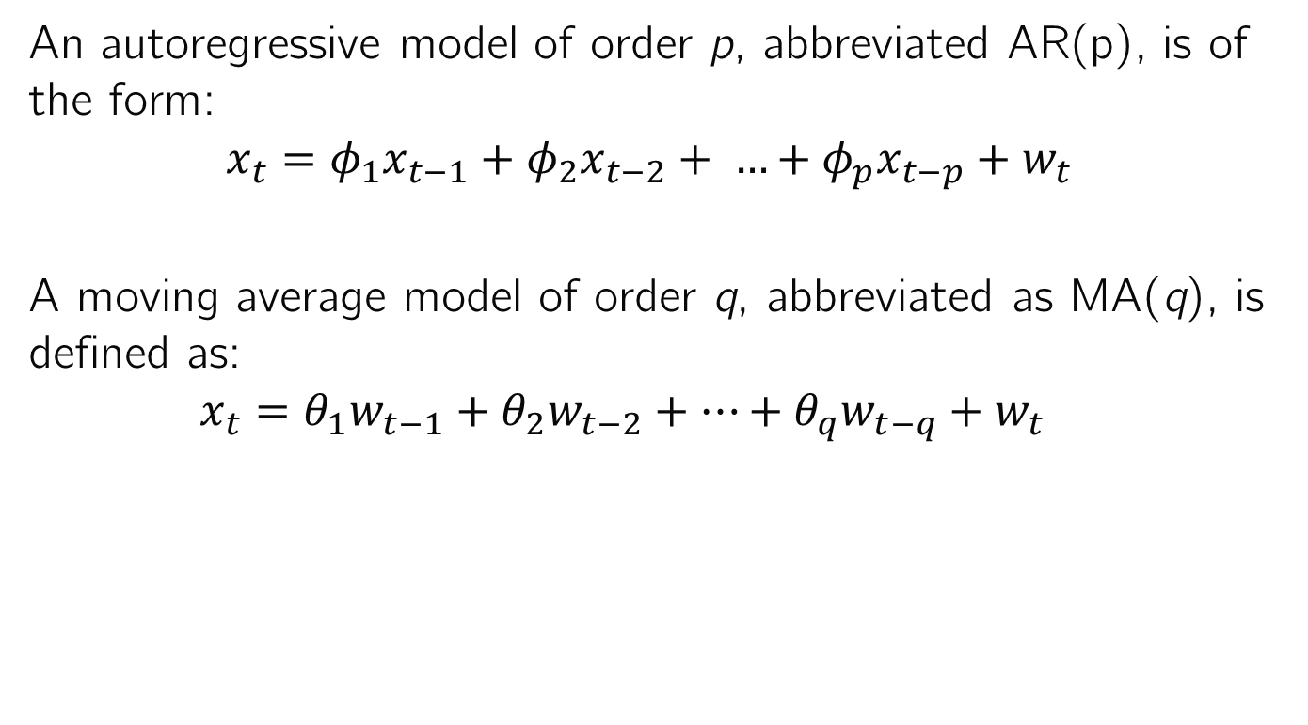
Review of AR and MA Models
An autoregressive model of order p, abbreviated AR(p), is of the form:
$$x_{t}=φ_{1}x_{t−1}+φ_{2}x_{t−2}+ …+φ_{p}x_{t−p}+w_{t}$$
A moving average model of order q, abbreviated as MA(q), is defined as:
$$x_{t}=θ_{1}w_{t−1}+θ_{2}w_{t−2}+…+θ_{q}w_{t−q}+w_{t}$$

Slide 4
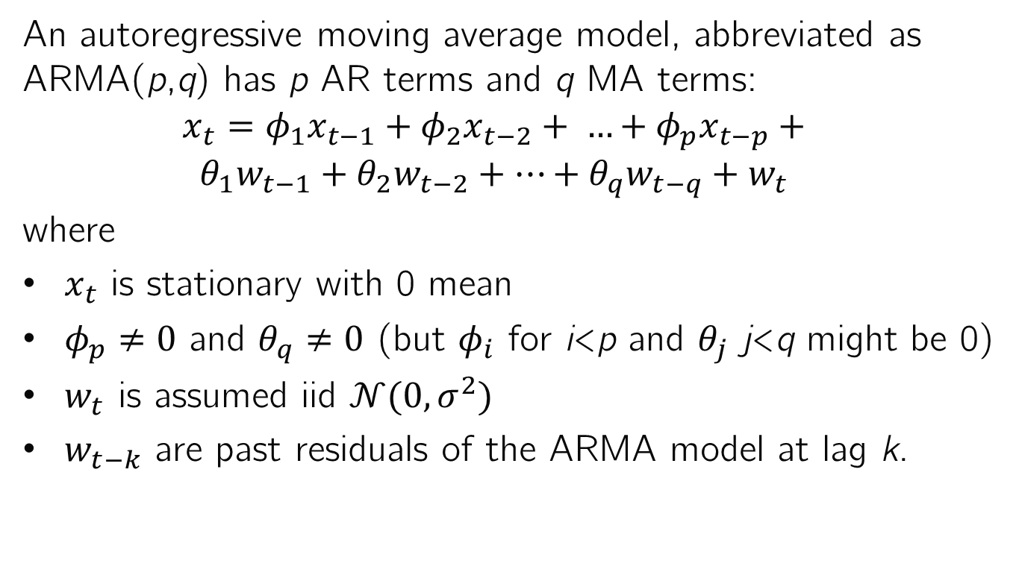
Review of ARMA Models
An autoregressive moving average model, abbreviated as ARMA(p,q) has p AR terms and q MA terms:
$$x_{t}=φ_{1}x_{t−1}+φ_{2}x_{t−2}+ …+φ_{p}x_{t−p}+$$
$$θ_{1}w_{t−1}+θ_{2}w_{t−2}+…+θ_{q}w_{t−q}+w_{t}$$
where
$x_{t}$ is stationary with 0 mean
$φ_{p}≠0$ and $θ_{q}≠0$ (but $φ_{i}$ for i<p and $θ_{j}$ j<q might be 0)
$w_{t}$ is assumed iid $𝒩(0,σ^{2})$
$w_{t−k}$ are past residuals of the ARMA model at lag k.

Slide 5
Behavior of ACF and PACF
We can often identify appropriate time series models from the autocorrelation and partial autocorrelation functions
 | Nonstationary | AR(p) | MA(q) | ARMA(p,q)
ACF
PACF
 | Nonstationary
ACF | Slow, linear decay
PACF
 | Nonstationary | AR(p)
ACF | Slow, linear decay | Sinusoidal or exponential decay
PACF |  | Cuts off after p lags
 | Nonstationary | AR(p) | MA(q)
ACF | Slow, linear decay | Sinusoidal or exponential decay | Cuts off after q lags
PACF |  | Cuts off after p lags | Sinusoidal or exponential decay
 | Nonstationary | AR(p) | MA(q) | ARMA(p,q)
ACF | Slow, linear decay | Sinusoidal or exponential decay | Cuts off after q lags | Sinusoidal or exponential decay
PACF |  | Cuts off after p lags | Sinusoidal or exponential decay | Sinusoidal or exponential decay

Slide 6
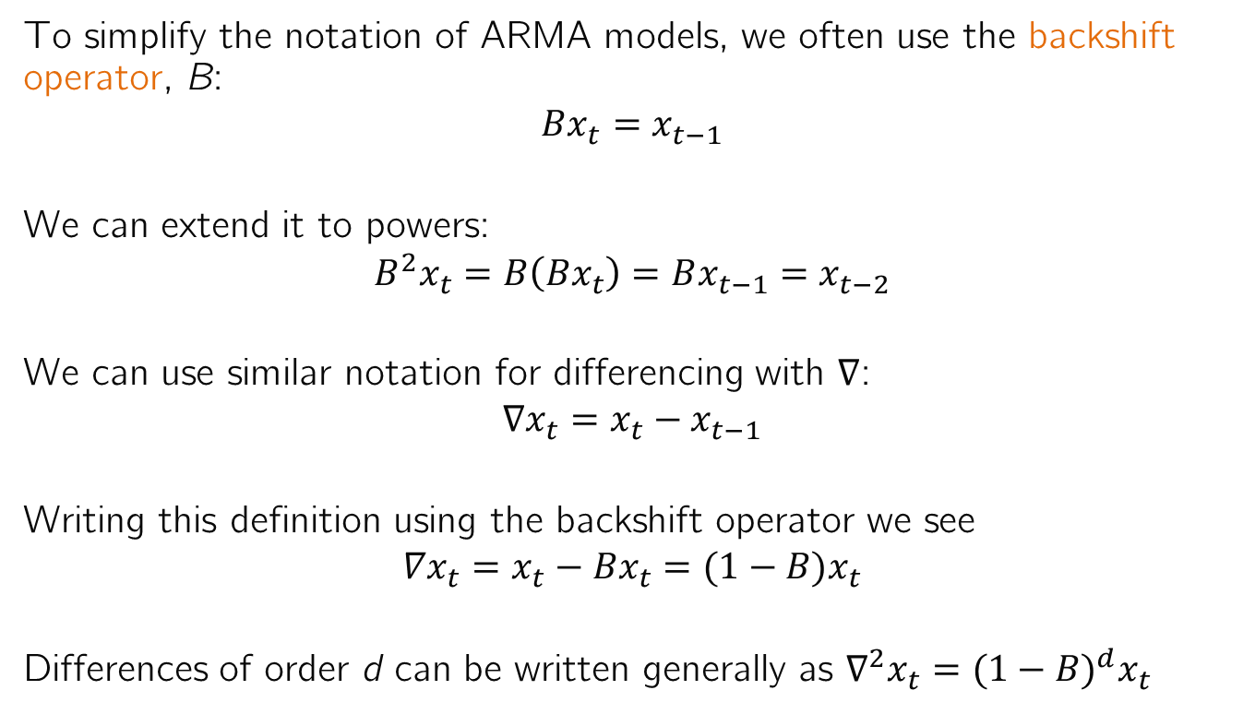
Backshift Operator
To simplify the notation of ARMA models, we often use the backshift operator, B:
$$Bx_{t}=x_{t−1}$$
We can extend it to powers:
$$B^{2}x_{t}=B\left({Bx}_{t}\right)=Bx_{t−1}=x_{t−2}$$
We can use similar notation for differencing with $∇$:
$$∇x_{t}=x_{t}−x_{t−1}$$
Writing this definition using the backshift operator we see
$$∇x_{t}=x_{t}−{Bx}_{t}=(1−B)x_{t}$$
Differences of order d can be written generally as $∇^{2}x_{t}={(1−B)}^{d}x_{t}$

Slide 7
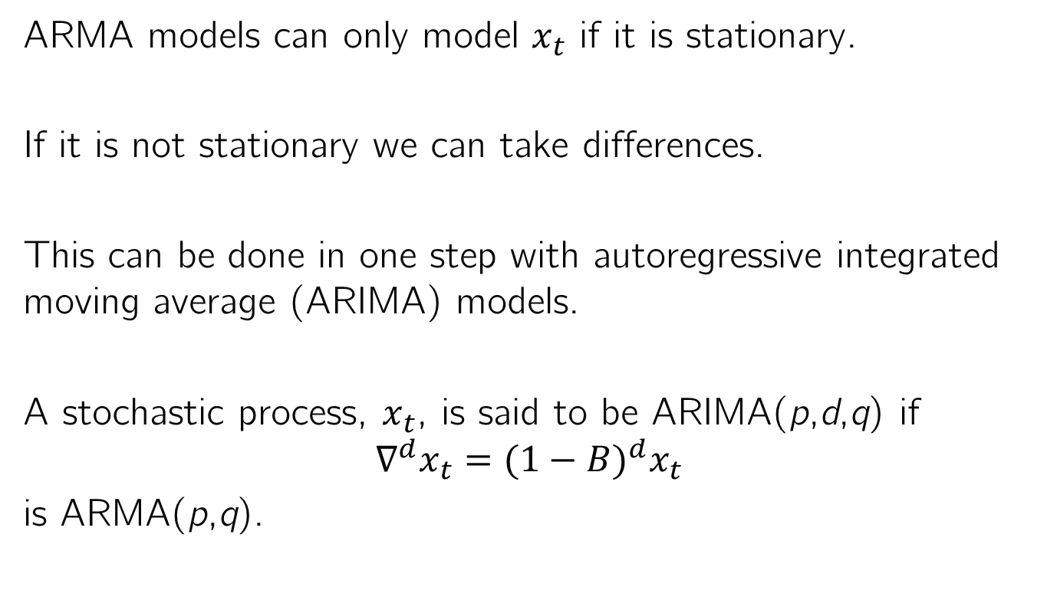
Autoregressive Integrated Moving Average Models
ARMA models can only model $x_{t}$ if it is stationary.
If it is not stationary we can take differences.
This can be done in one step with autoregressive integrated moving average (ARIMA) models.
A stochastic process, $x_{t}$, is said to be ARIMA(p,d,q) if
$$∇^{d}x_{t}={(1−B)}^{d}x_{t}$$
is ARMA(p,q).

Slide 8
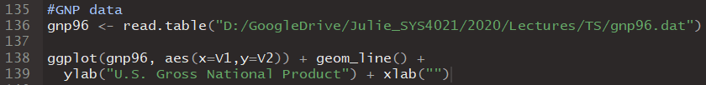
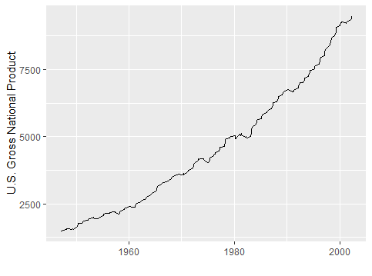

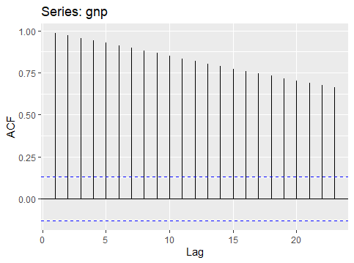
Example ARIMA time series: GNP

Slide 9
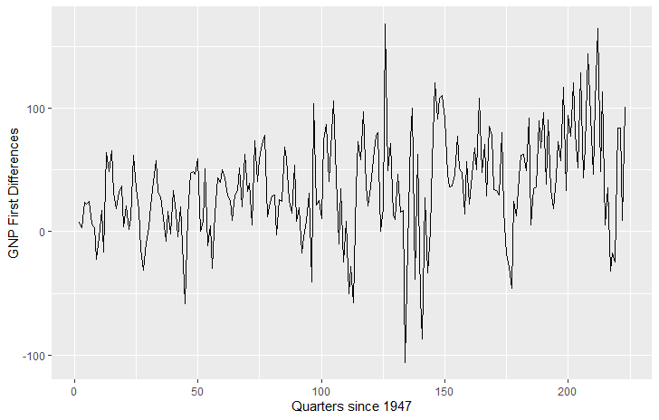
Example ARIMA time series: GNP

Slide 10

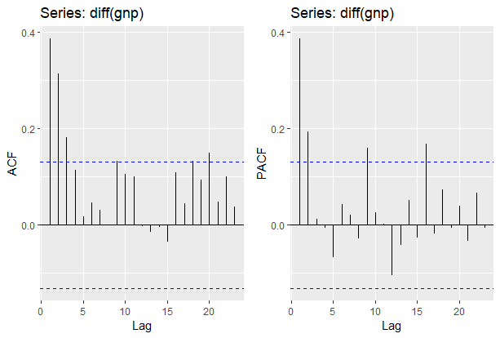
Example ARIMA time series: GNP
AR(2) model of first differences seems appropriate, so ARIMA(2,1,0) of GNP
ACF decays exponentially and then stays fairly insignificant
PACF cuts off after 2 lags

Slide 11
Diagnostics in Time Series Analysis
We now know several models we can use to capture autocorrelation in a time series, or in the residuals of a trend + seasonality model of a time series.
But how do we know if these models are adequate?
We want a model that is parsimonious as possible: we need enough parameters to model correlated observations, but we don’t want to overfit the data and increase the variance of our forecasts.
As with MLR, we will assess model performance with both metrics like AIC, BIC, Adjusted R² and diagnostics.

Slide 12
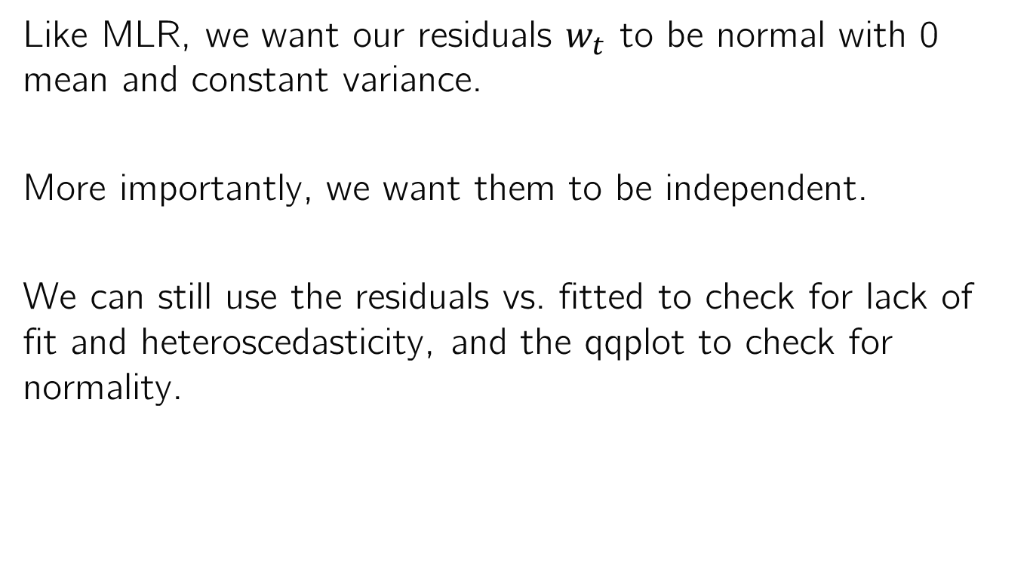
Diagnostics in Time Series Analysis
Like MLR, we want our residuals $w_{t}$ to be normal with 0 mean and constant variance.
More importantly, we want them to be independent.
We can still use the residuals vs. fitted to check for lack of fit and heteroscedasticity, and the qqplot to check for normality.

Slide 13

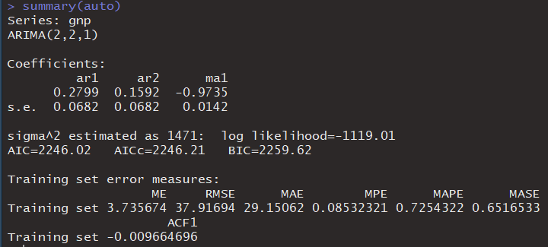
GNP ARIMA model diagnostics
Finds ARIMA model that minimizes the AIC
Optimal model for AIC is an ARMA(2,1) model on the second differences (d=2)

Slide 14
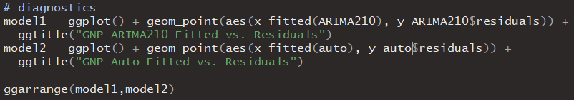
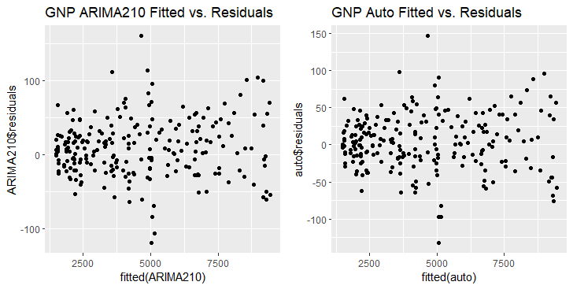
GNP ARIMA model diagnostics
Residuals vs. fitted look similar for both models

Slide 15
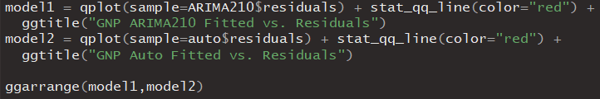
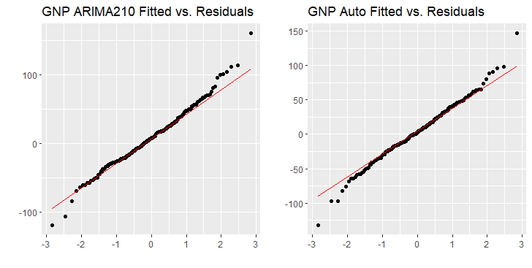
GNP ARIMA model diagnostics
Residuals are about equally Gaussian for both models

Slide 16
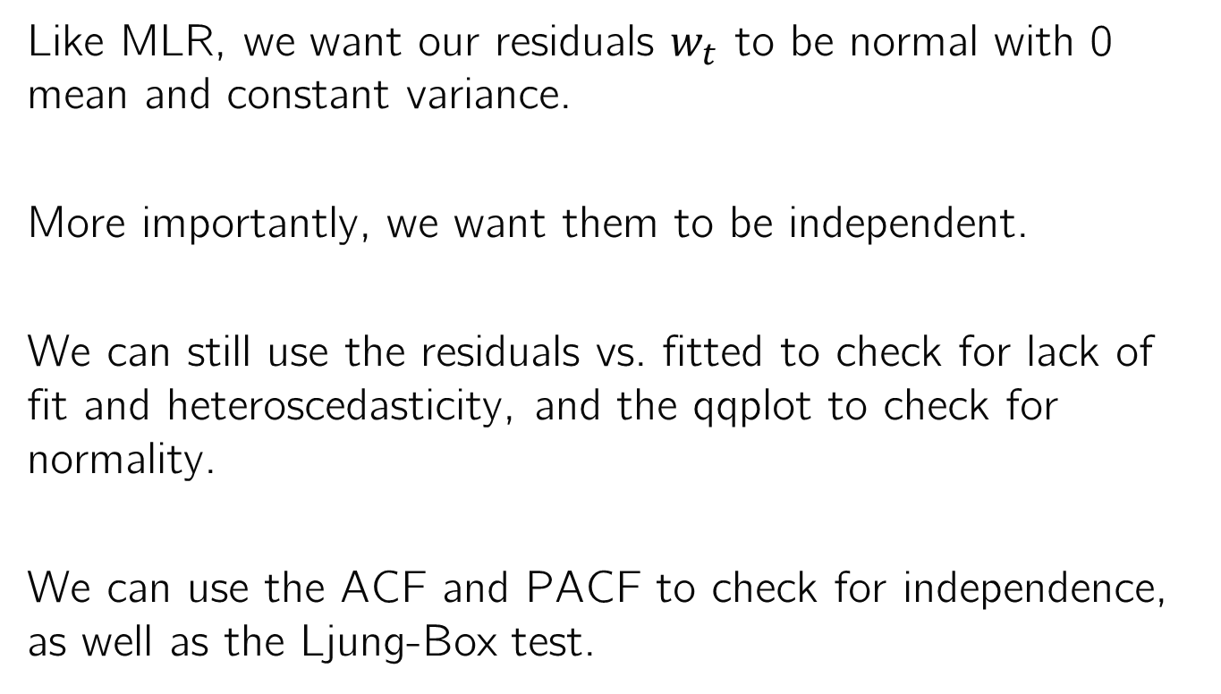
Diagnostics in Time Series Analysis
Like MLR, we want our residuals $w_{t}$ to be normal with 0 mean and constant variance.
More importantly, we want them to be independent.
We can still use the residuals vs. fitted to check for lack of fit and heteroscedasticity, and the qqplot to check for normality.
We can use the ACF and PACF to check for independence, as well as the Ljung-Box test.

Slide 17
Ljung Box Test
The Ljung-Box test determines whether the first H sample autocorrelations of the residuals, considered together, are significant.
H0: Autocorrelation is not significant (model is adequate up to lag H)
Ha: Autocorrelation is significant (model is not adequate up to lag H)

Slide 18
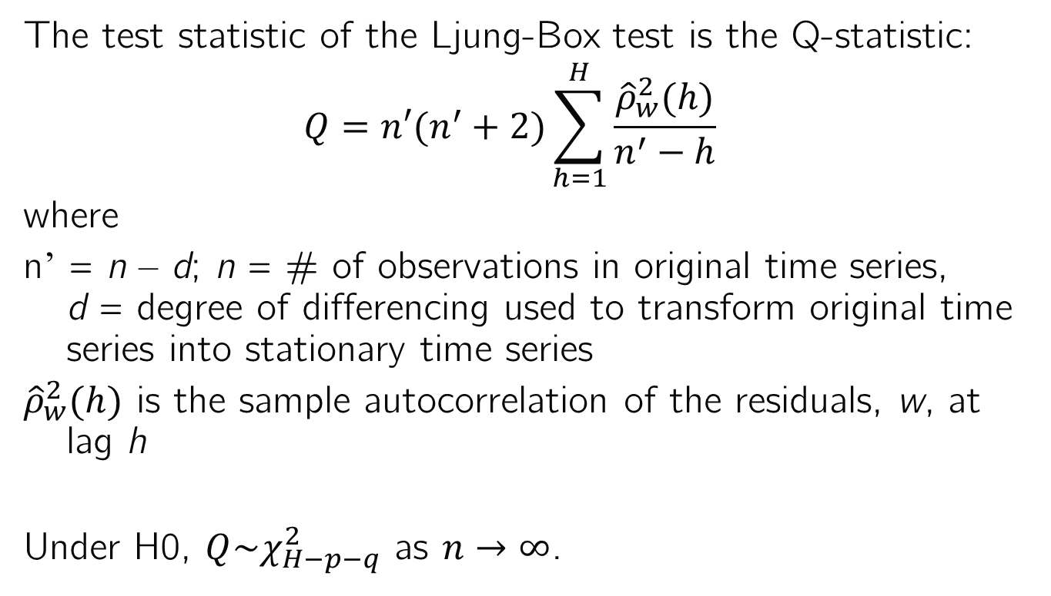
Ljung-Box Test
The test statistic of the Ljung-Box test is the Q-statistic:
$$Q=n′(n^{′}+2)\sum_{h=1}^{H}{\frac{{\hat{ρ}}_{w}^{2}(h)}{n^{′}−h}}$$
where
n’ = n – d; n = # of observations in original time series, d = degree of differencing used to transform original time series into stationary time series
${\hat{ρ}}_{w}^{2}(h)$ is the sample autocorrelation of the residuals, w, at lag h
Under H0, $Q\sim χ_{H−p−q}^{2}$ as $n→∞$.

Slide 19

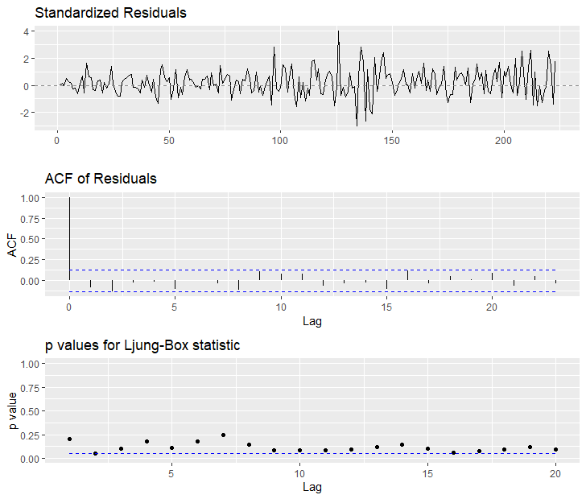
GNP ARIMA model diagnostics
If the p-value is <0.05, i.e. below the blue line, we reject H0 that the correlations are not significant.
That is, we reject that the model is adequate at that lag. So the higher the dots, the better.
This model becomes inadequate after only 1 lag.

Slide 20
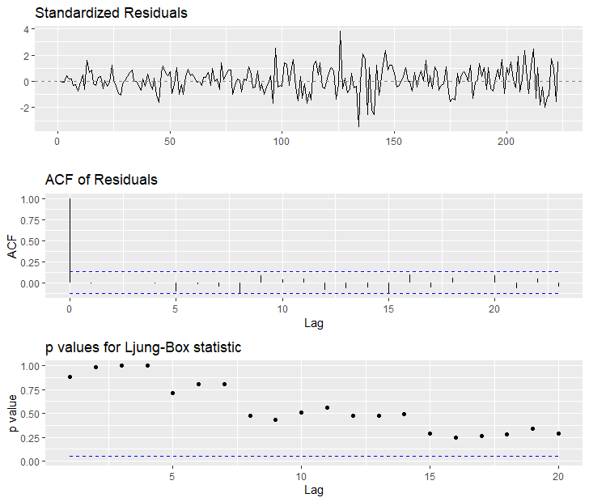
GNP ARIMA model diagnostics
The auto.arima model, which was ARIMA(2,2,1), is good for at least 20 lags.
Therefore this model outperforms the ARIMA(2,1,0) model in both AIC and diagnostics.

Slide 21
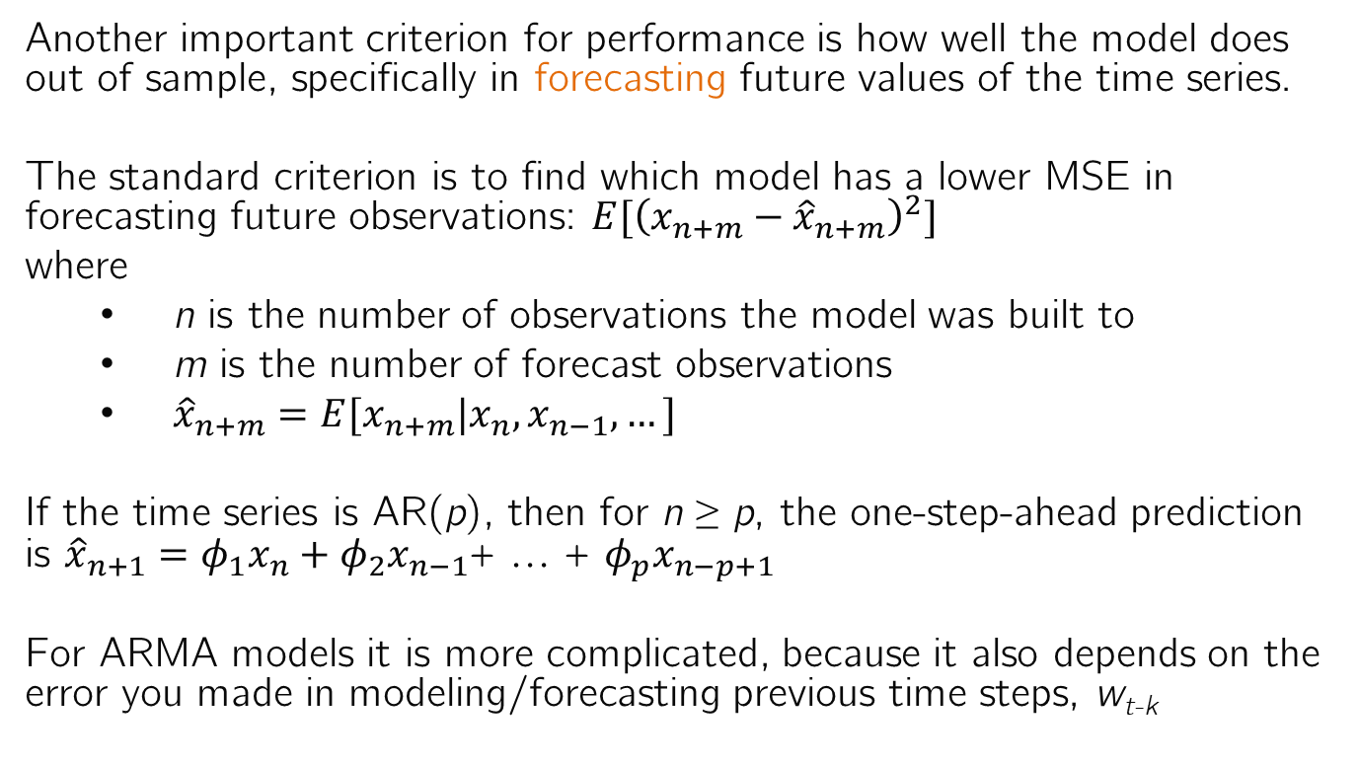
Forecasting
Another important criterion for performance is how well the model does out of sample, specifically in forecasting future values of the time series.
The standard criterion is to find which model has a lower MSE in forecasting future observations: $E[{\left(x_{n+m}−{\hat{x}}_{n+m}\right)}^{2}]$
where
n is the number of observations the model was built to
m is the number of forecast observations
${\hat{x}}_{n+m}=E[x_{n+m}|x_{n},x_{n−1},…]$
If the time series is AR(p), then for n ≥ p, the one-step-ahead prediction is ${\hat{x}}_{n+1}=φ_{1}x_{n}+φ_{2}x_{n−1}$+ … + $φ_{p}x_{n−p+1}$
For ARMA models it is more complicated, because it also depends on the error you made in modeling/forecasting previous time steps, w_{t-k}

Slide 22
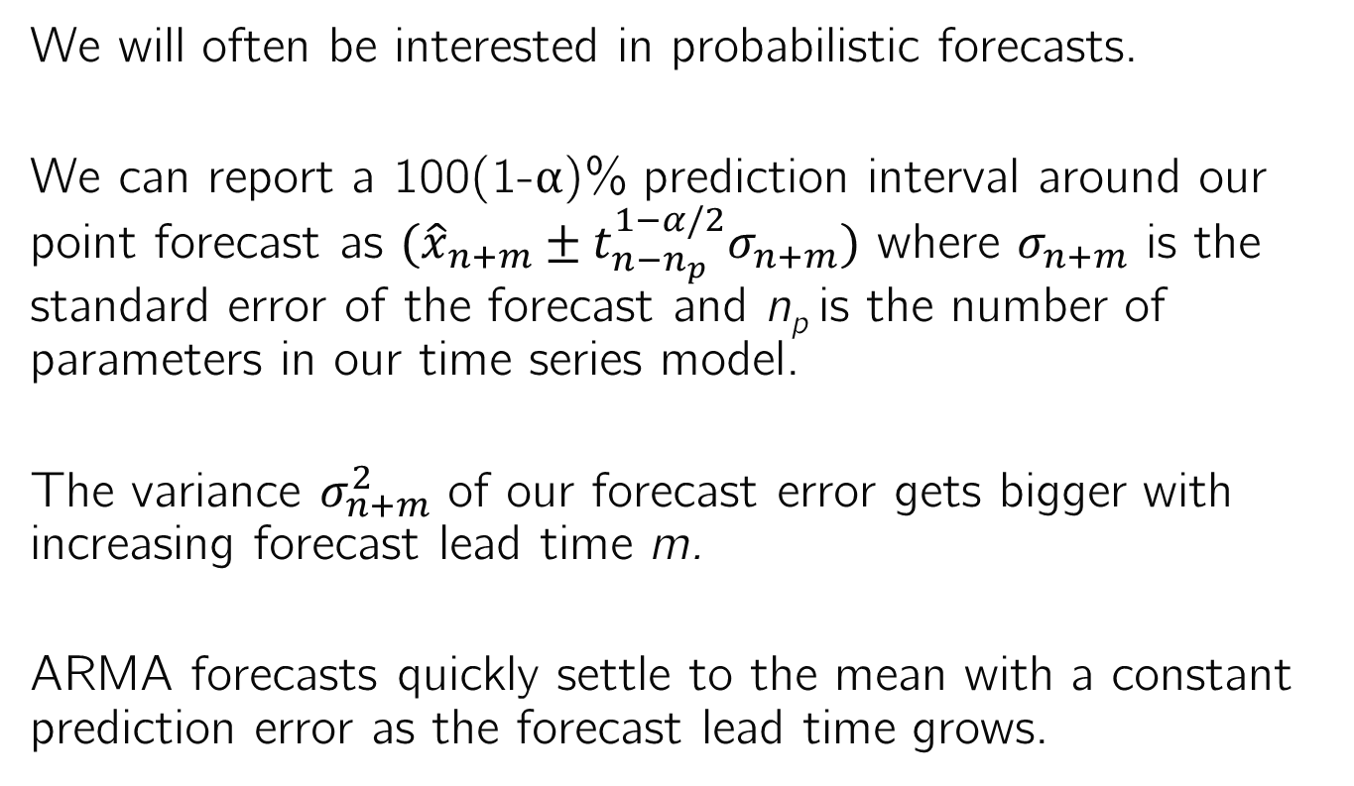
Forecasting
We will often be interested in probabilistic forecasts.
We can report a 100(1-α)% prediction interval around our point forecast as $({\hat{x}}_{n+m}±t_{n−n_{p}}^{1−α/2}σ_{n+m})$ where $σ_{n+m}$ is the standard error of the forecast and n_{p} is the number of parameters in our time series model.
The variance $σ_{n+m}^{2}$ of our forecast error gets bigger with increasing forecast lead time m.
ARMA forecasts quickly settle to the mean with a constant prediction error as the forecast lead time grows.

Slide 23
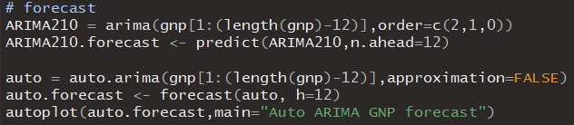
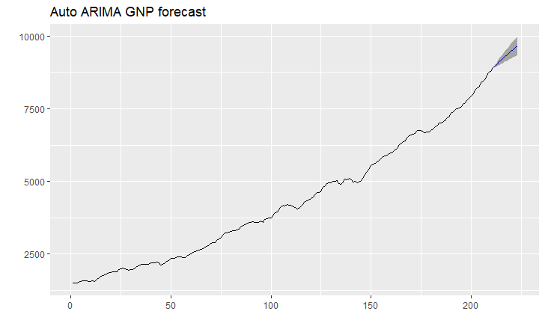
Example Forecast with GNP data
Build a forecast to all but the last 3 years of quarterly GNP and then forecast the remainder.
Forecast and 95% confidence interval

Slide 24
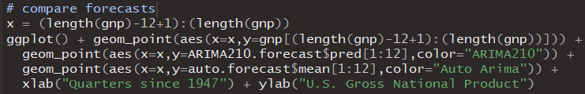
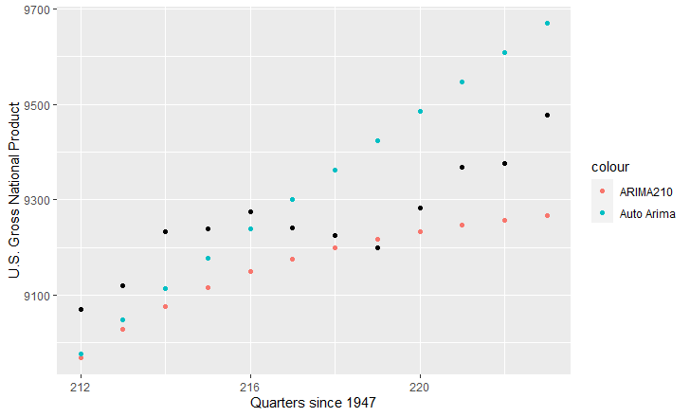
Example Forecast with GNP data
Build a forecast to all but the last 3 years of quarterly GNP and then forecast the remainder.

Slide 25


Example Forecast with GNP data
Build a forecast to all but the last 3 years of quarterly GNP and then forecast the remainder.
While the auto.arima model (ARIMA(2,2,1)) had better diagnostics and a lower AIC, the ARIMA(2,1,0) model had a lower forecast MSE

Slide 26
Box Jenkins Time Series Model-Building Process
Tentative Identification: Historical time series data are used to identify possible ARIMA models.
Estimation: Estimate the parameters of the tentatively identified models.
Diagnostic checking: Check the adequacy of the tentatively identified models.
Forecasting: Once a final model is selected, it is used to forecast future time series values.

